Slide 1

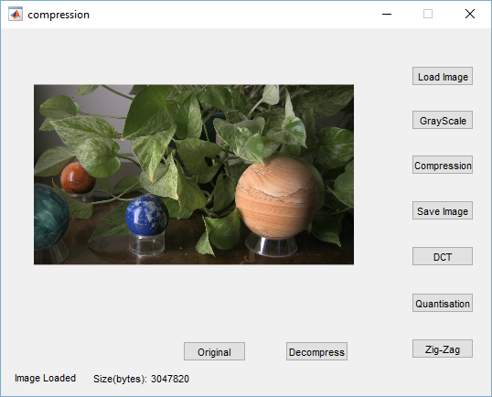
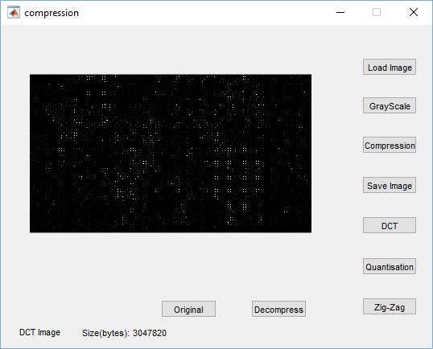
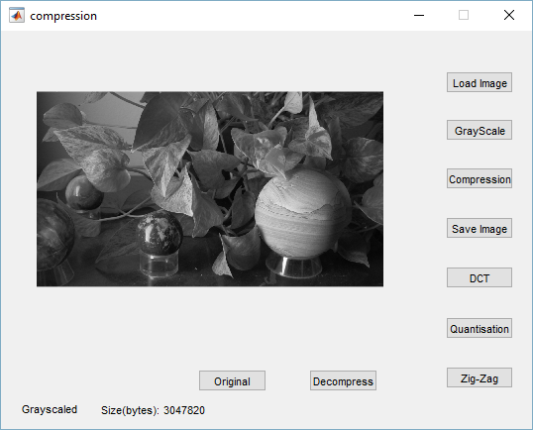
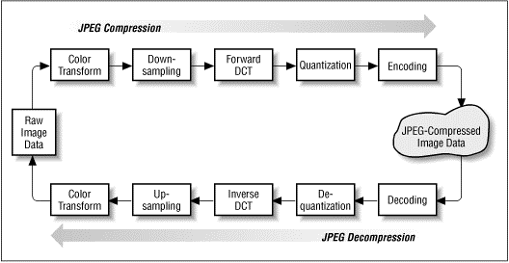


LOSSY IMAGE COMPRESSION USING JPEG ALGORITHM
OBJECTIVE
To compress the image using JPEG algorithms
Features
Can easily compress a file to one-fifth of its original size
JPEG compression can be used in a variety of file formats that are commonly used in graphic arts:
-EPS files
-EPS DCS files
-JFIF files
-PDF files
MADE BY:
Rubal Bansal (101412031)
Sarthak Chaudhary (101412034)

